Slide 1
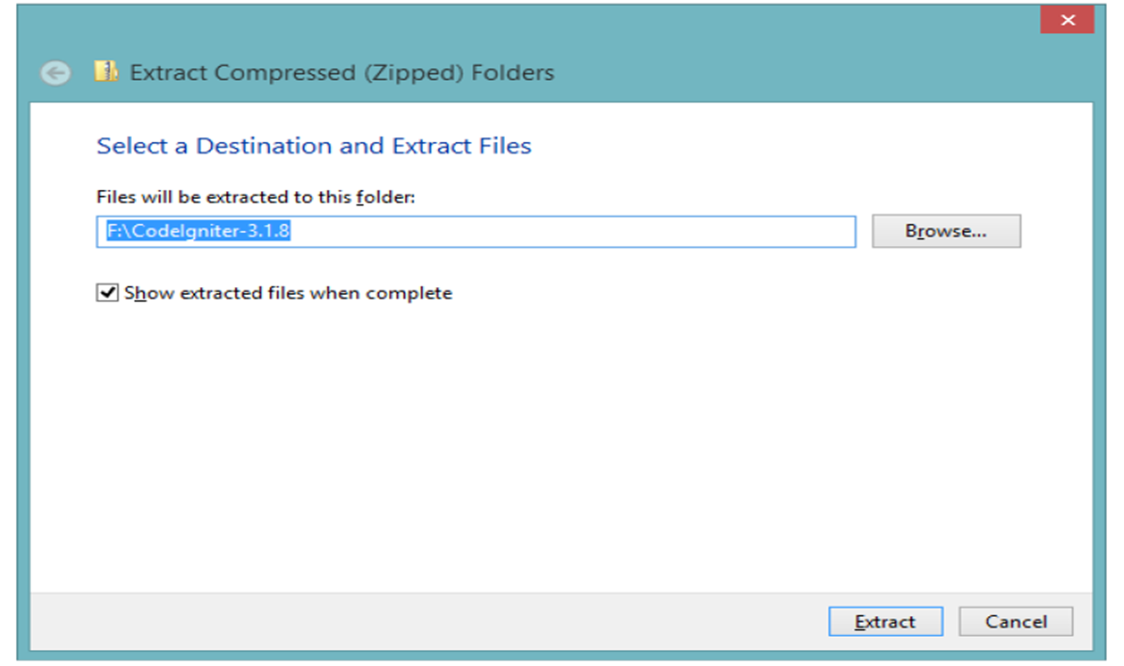
Pertemuan 11 : MVC (Model View Control) dengan CI
1. Download CI :
Extraxt CI di htdocs rename hasil extract sesuai nama proyek
Misal : coba_ci

Slide 2

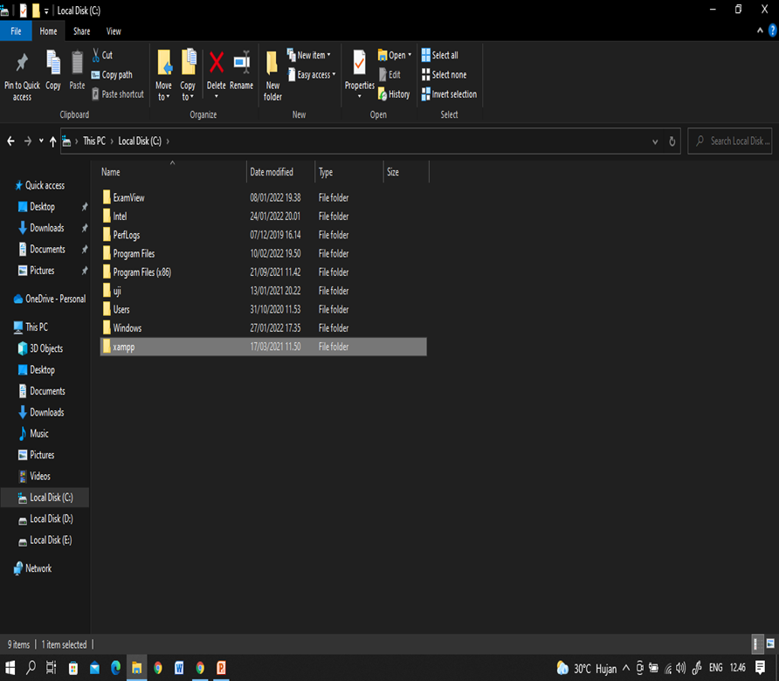
Pilih folder xampp

Slide 3
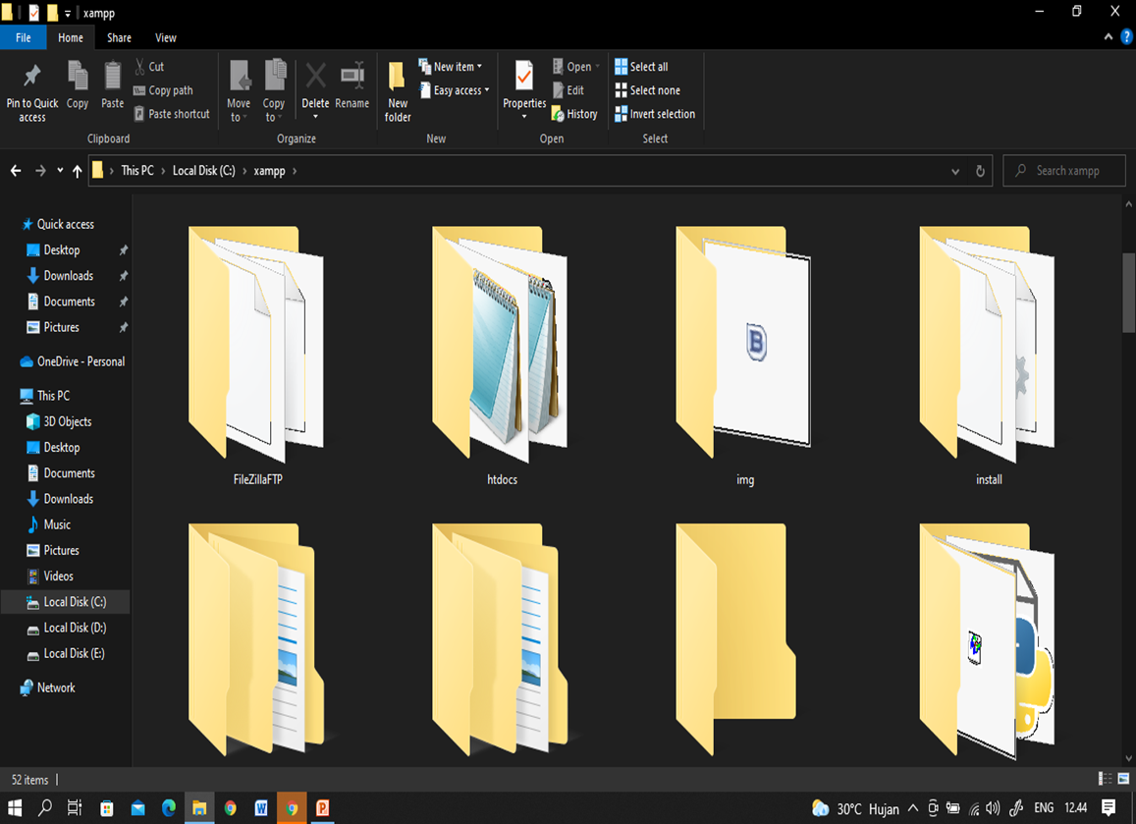
Pilih folder htdocs

Slide 4
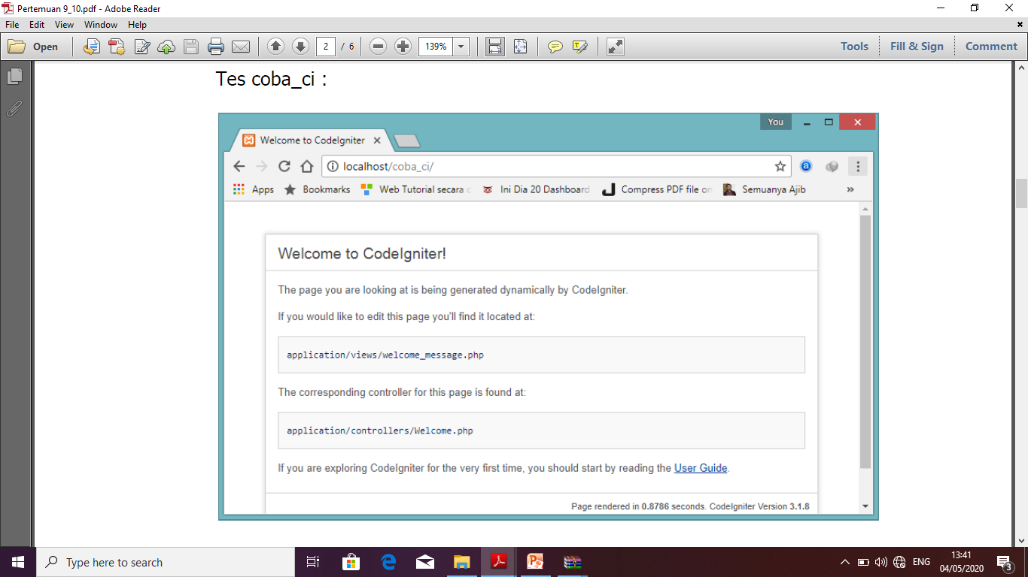

Slide 5
Buat code MVC berikut :
model/modelku.php
<?php
class Modelku extends CI_Model
{
public function getData(){
return array(
'matkul' => "Pemrograman Web Lanjut",
'kelompok' => "4401U",
'lab' => "D.2.D"
);
}
}
?>

Slide 6
view/hello_ci.php
<html>
<head>
<title></title>
</head>
<body>
<h1>Selamat Datang</h1>
<p> Belajar CI View</p>
<?php echo $matkul.'<br>'; ?>
<?php echo $kelompok.'<br>'; ?>
<?php echo $lab.'<br>'; ?>
</body>
</html>

Slide 7
controller/helloworld.php
<?php
defined('BASEPATH') OR exit('No direct script access allowed');
class Helloworld extends CI_Controller {
public function index()
{
//echo "Hello world!!!!";
$this->load->model('modelku');
$data=$this->modelku->getData();
$this->load->view('hello_ci', $data);
}
}

Slide 8
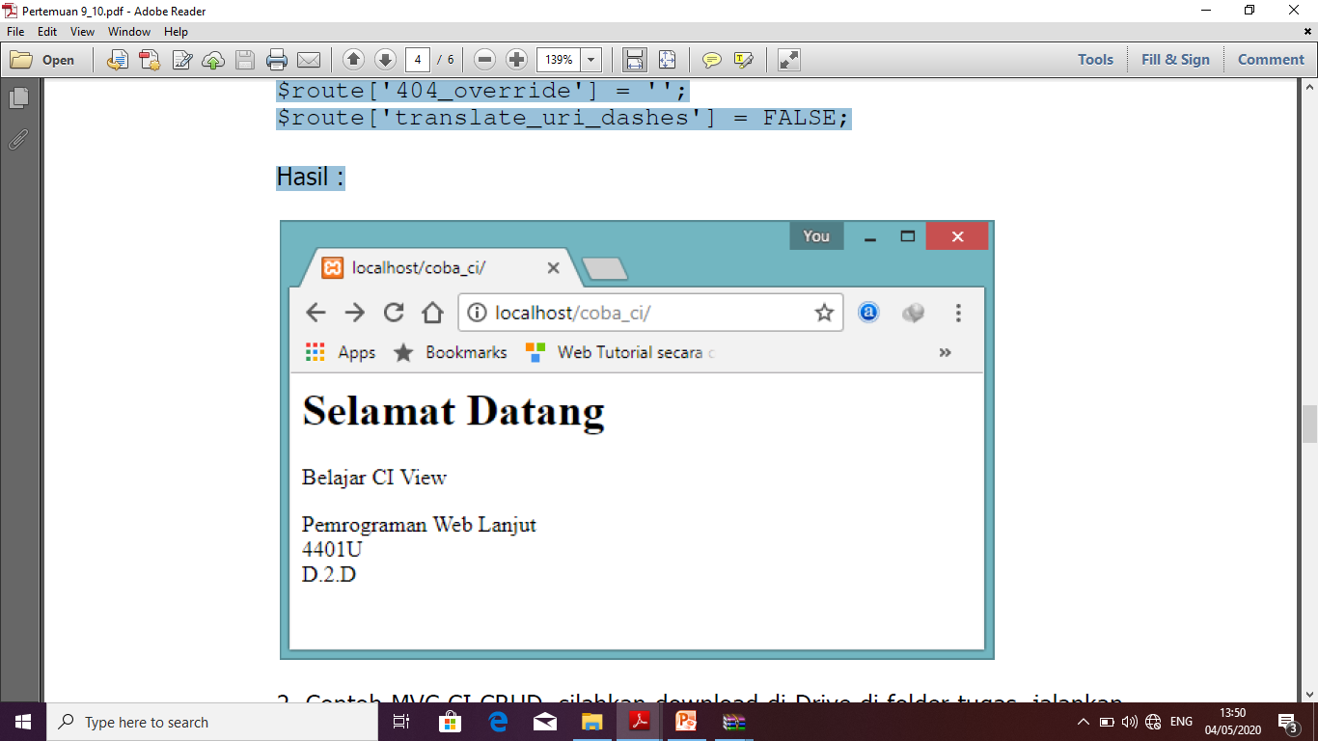
Update routes.php
//$route['default_controller'] = 'welcome';
$route['default_controller'] = 'helloworld';
$route['404_override'] = '';
$route['translate_uri_dashes'] = FALSE;
Hasil :

